Slide 1
Lecture 3
Introduction to C++
Konstantin Leladze
C++ Basics
DIHT MIPT 2021

Slide 2
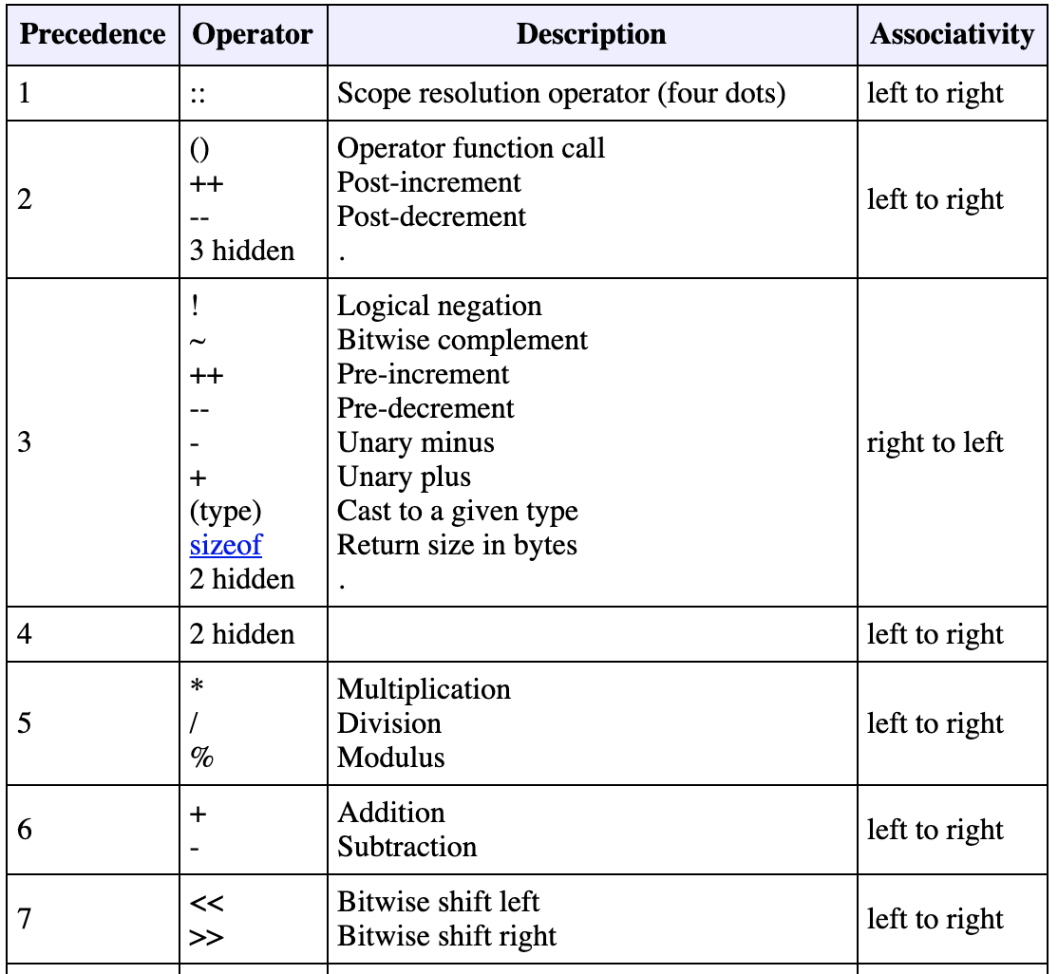
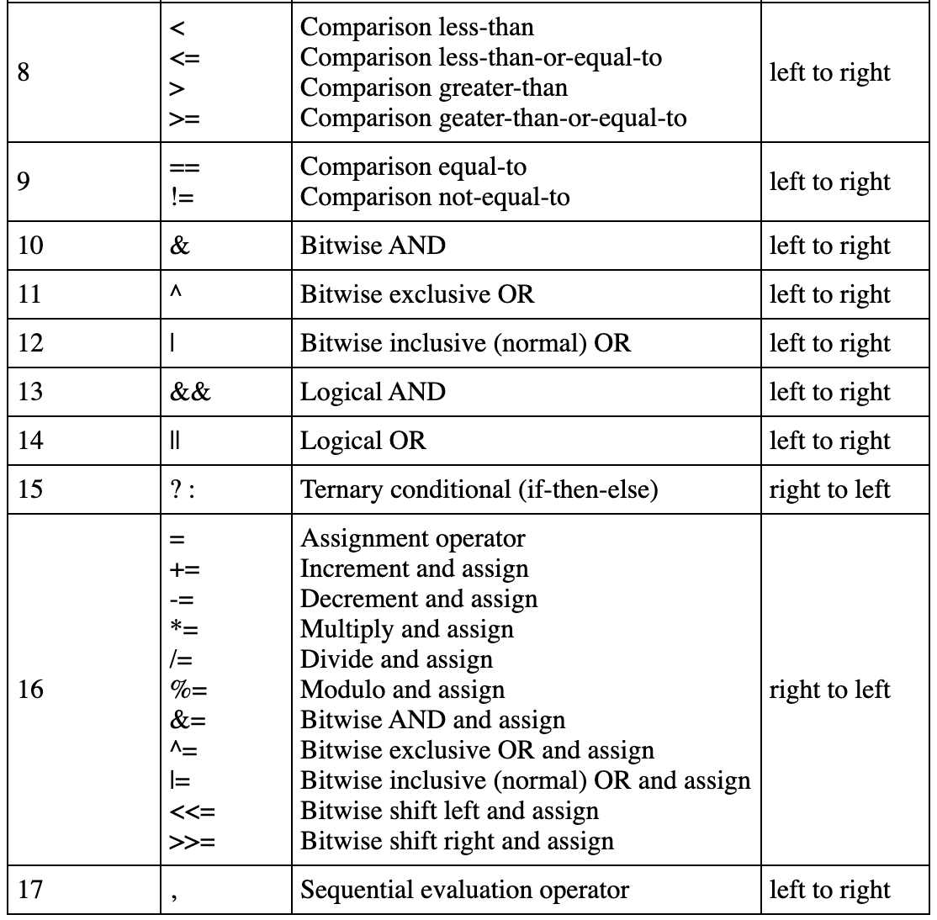
Operators is C++ (Summary)
What are the values of x and y equal to after execution of this instruction (by default x and y equal to 13):
x += y %= (3, 4, 5 * 1 + 2 * 4 - 3)

Slide 3
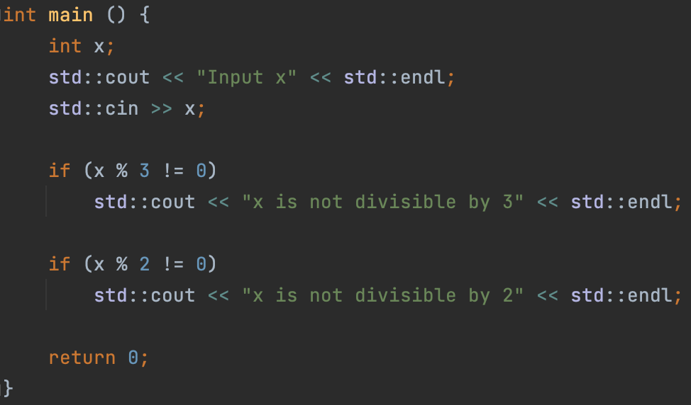
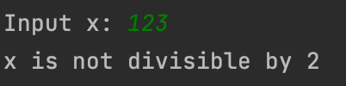
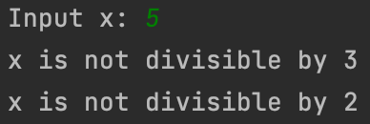

Control sequences
if condition
Syntax :
if (boolean expression or expression, convertible to bool)
statement or composite-statement
Statement will be executed if and only if the expression in parenthesis evaluates to true

Slide 4
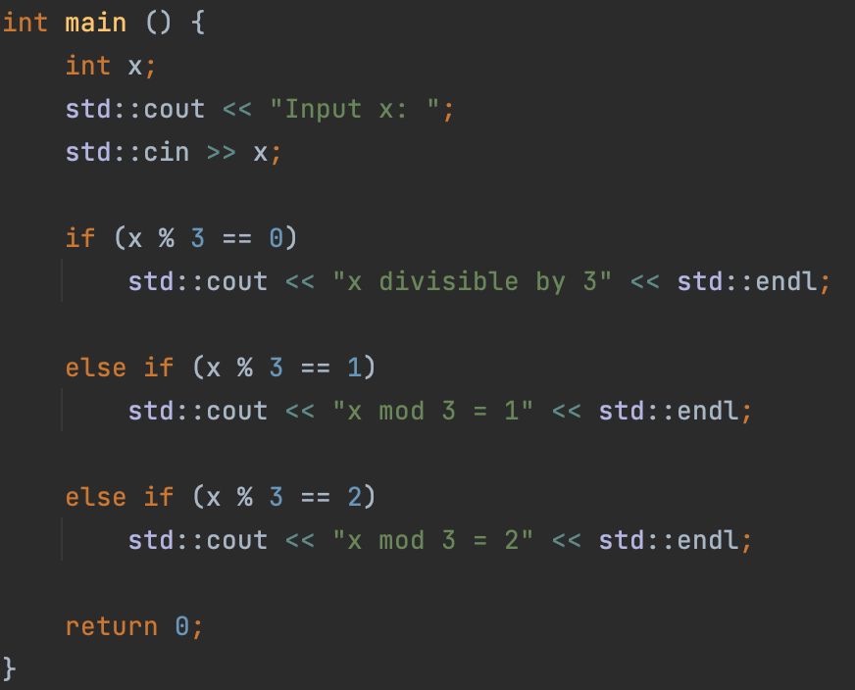



Control sequences
else if condition
Syntax :
Else if statent must follow if statement or else if statement. Otherwise, the program won’t compile.
else if (boolean expression, or expression, convertible to bool)
statement or composite-statement
Statement will be executed if and only if the expression in parenthesis evaluates to true and the expression in parenthesis of the previos if condition evaluates to false and all of the expressions in parenthesis of previous else if conditions also evluates to false

Slide 5
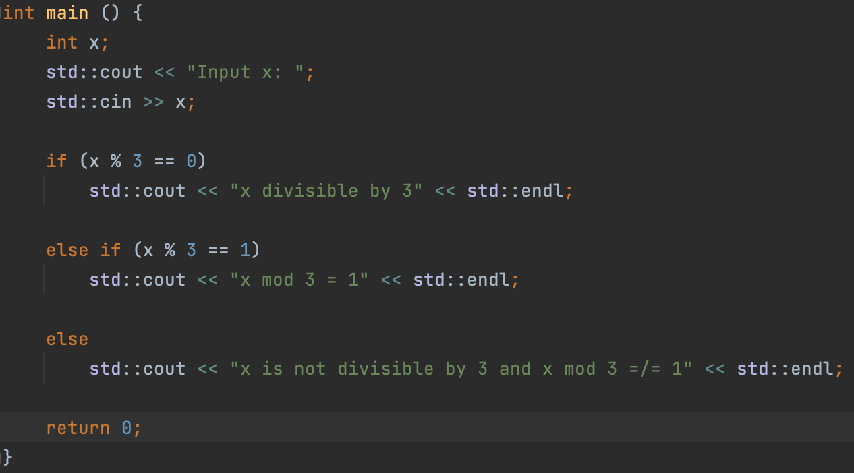


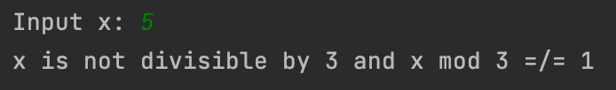
Control sequences
else condition
Syntax:
Else statent must follow if condition or else if condition. Otherwise, the program won’t compile.
else
statement or composite-statement
Statement will be executed if and only if the expression in parenthesis of the previos if condition evaluates to false and all of the expressions in parenthesis of previous else if conditions also evluates to false

Slide 6
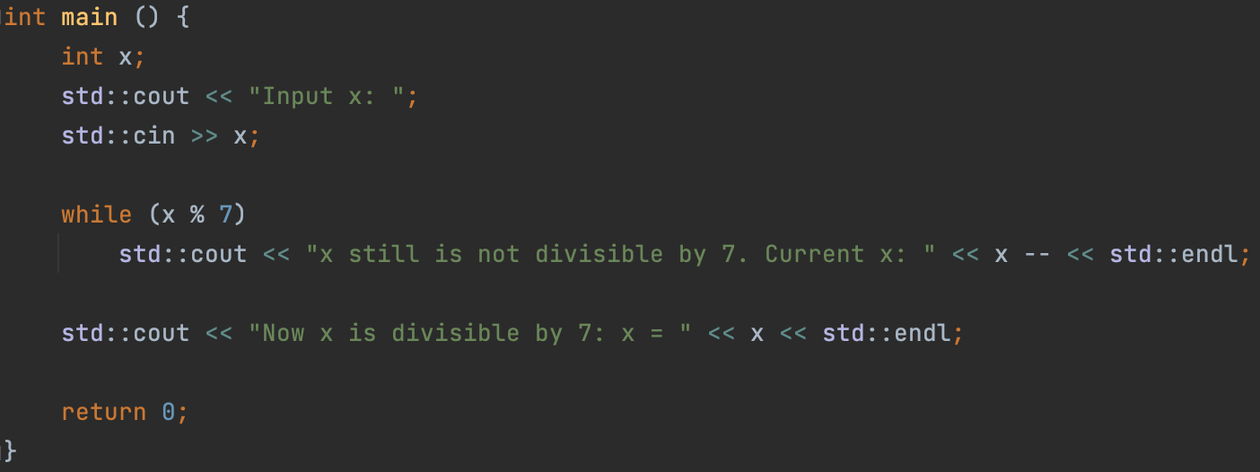
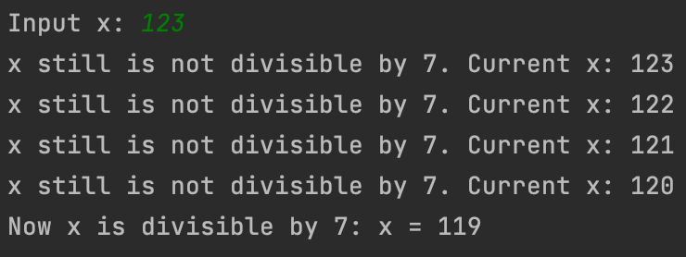
Control sequences
while loop
Syntax:
while (boolean expression, or expression, convertible to bool)
statement or composite-statement
Statement or composite statement will be executed over and over again as long as the condition is true.

Slide 7
Control sequences
while loop
Syntax:
while (boolean expression, or expression, convertible to bool)
statement or composite-statement
Statement or composite statement will be executed over and over again as long as the condition is true.

Slide 8
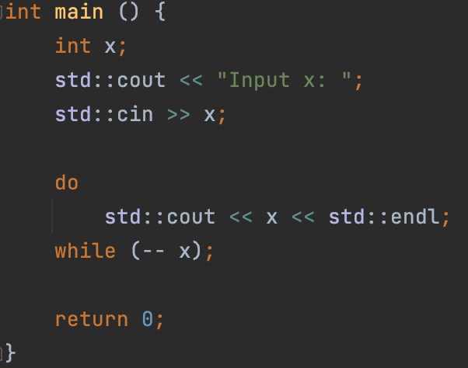
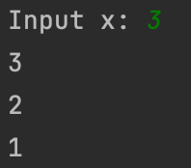
Control sequences
do-while loop
Syntax:
do
statement or composite-statement
while (boolean expression, or expression, convertible to bool);
Statement or composite statement will be executed unconditionally once, then, if the expression in condition evaluates to true, the statement will be executed again, etc...

Slide 9
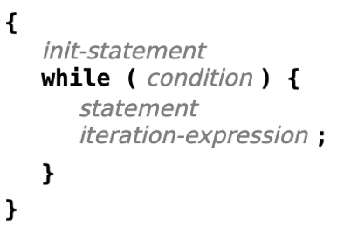
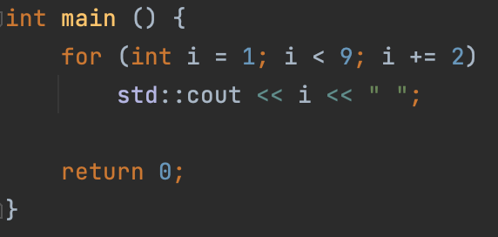

Control sequences
for loop
Syntax:
for (declaration or expr [init statement]; boolean expression [condition]; expression [iter expr])
statement or composite statement
The above syntax produces code almost equivalent to:
Exaple:

Slide 10
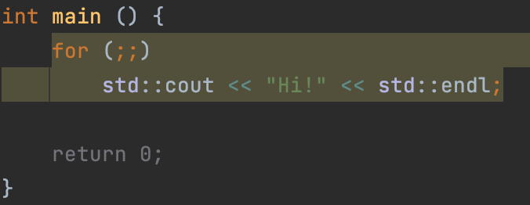
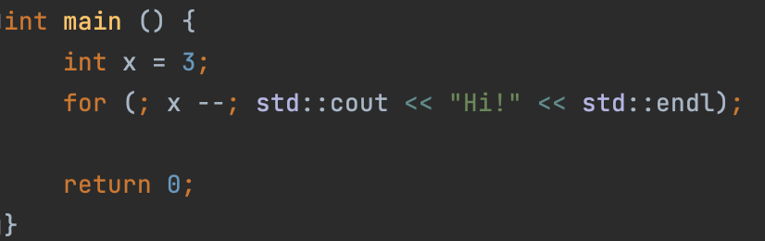

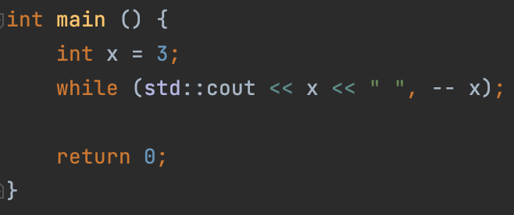

Control sequences
for loop
Every instruction in parenthesis can be omitted.
Also, even statement can be omitted (same as for the while loop)
Infinite for loop:
Omitted statement:
Omitted statement:

Slide 11
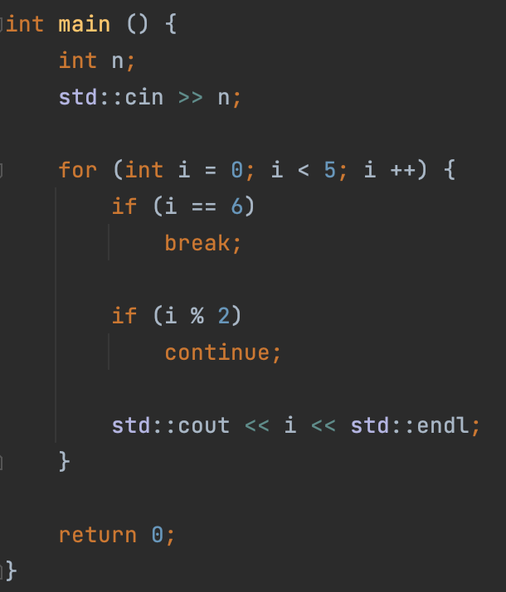

Control sequences
Continue and break keywords
Continue
Unconditionally proceeds to the next iteration of the current loop
Break
Unconditionally terminates the current loop
Important:
break is not the same as return
(lol, how can you possibly confuse them… ?)

Slide 12
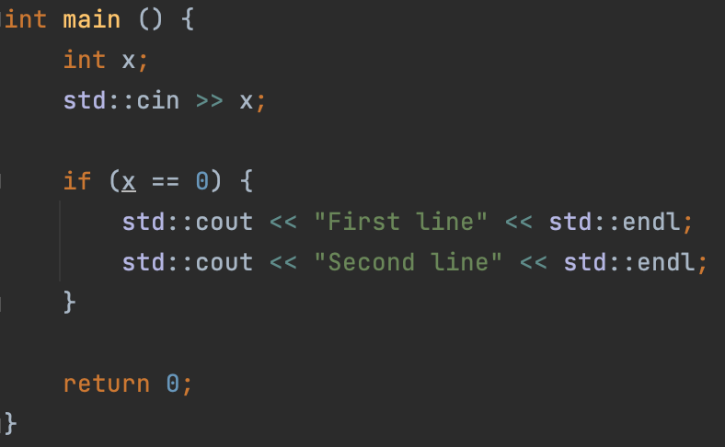
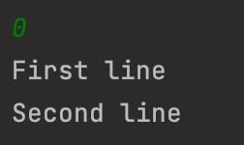
Control sequences
Composite statement examples:

Slide 13
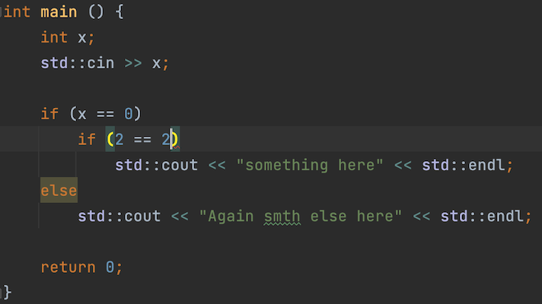
Control sequences
Common mistake:

Slide 14
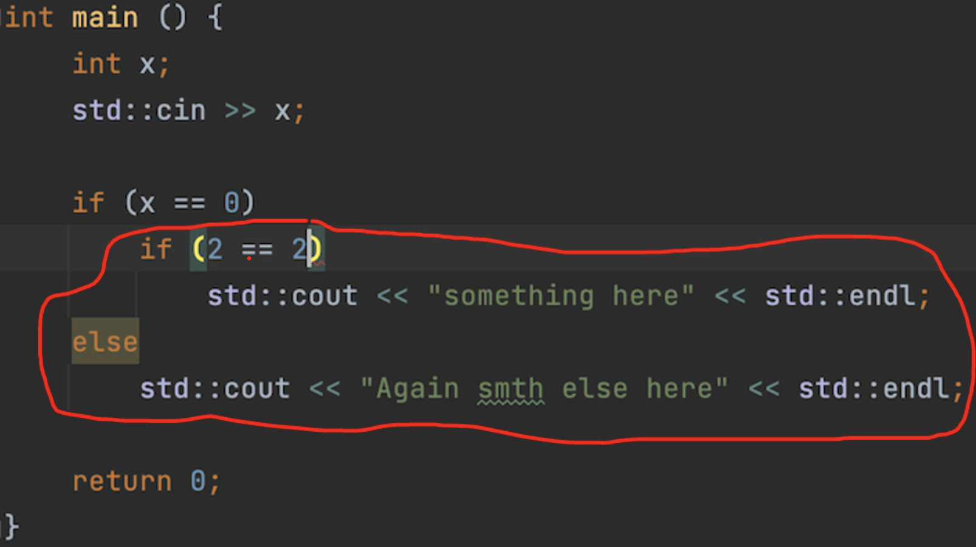
Control sequences
Common mistake:

Slide 15
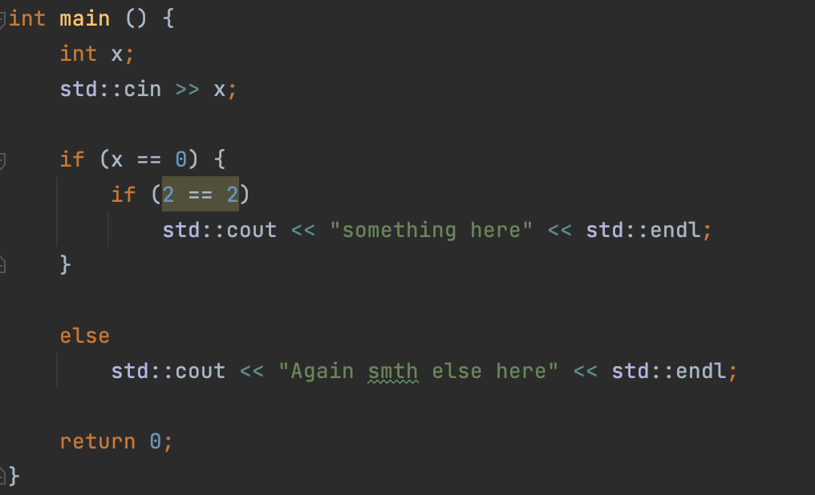
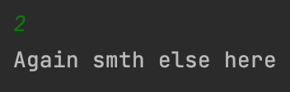
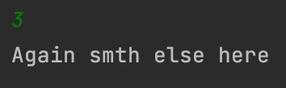
Control sequences
Solution:

Slide 16
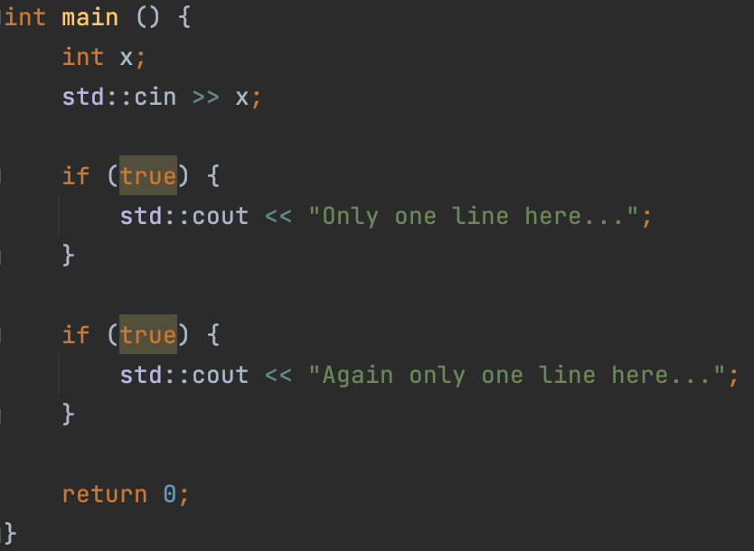
Control sequences
How to avoid:
BAD: Always put figure brackets and use composite statements…
GOOD: Memorize how this mechanism works

Slide 17
Control sequences
Switch / case
Nice replacement for if-else if-else when you have similar conditions in parenthesis:
switch (expression) {
case expression:
statements
[break;]
…
default:
statements
[break;]
}

Slide 18
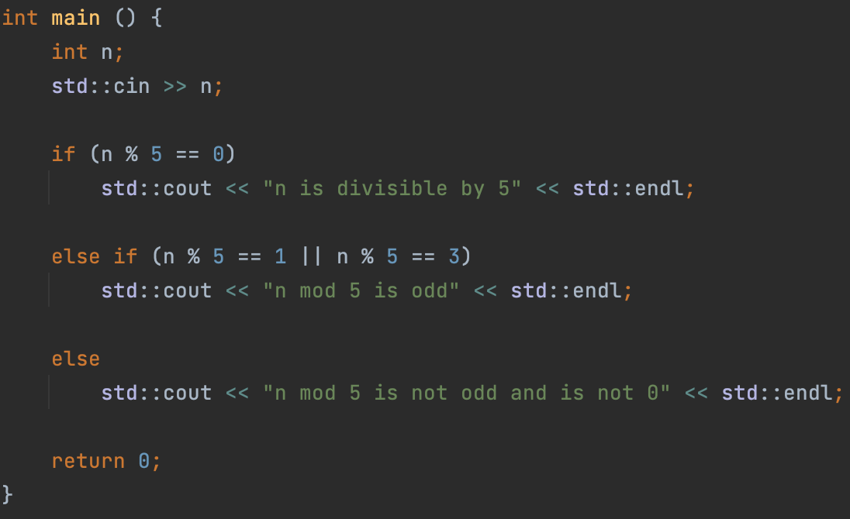
Control sequences
Switch / case
Example:

Slide 19
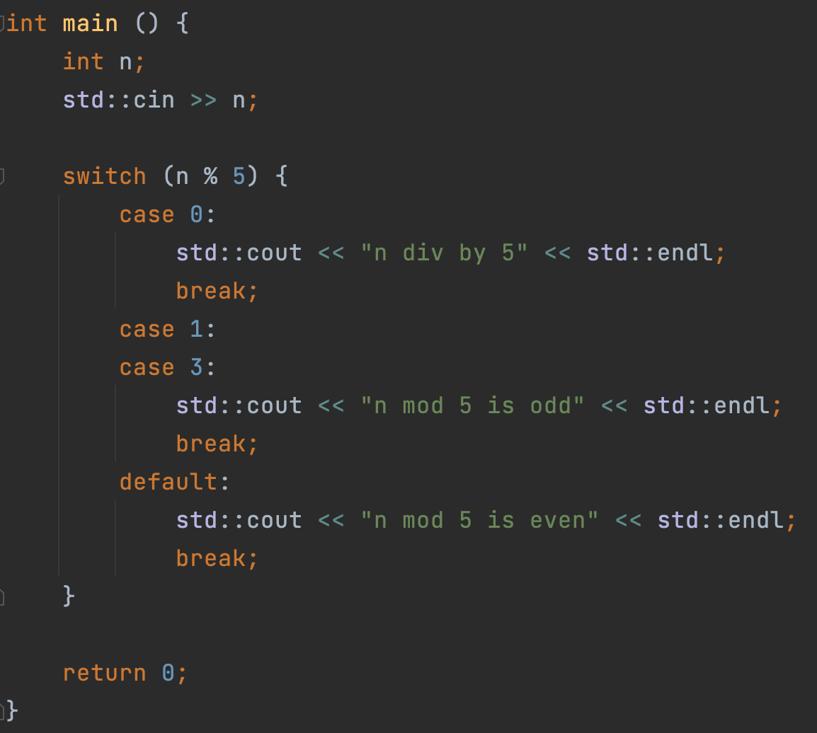
Control sequences
Switch / case
Example:

Slide 20
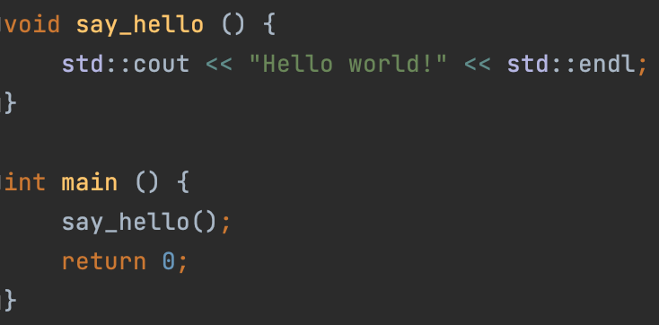
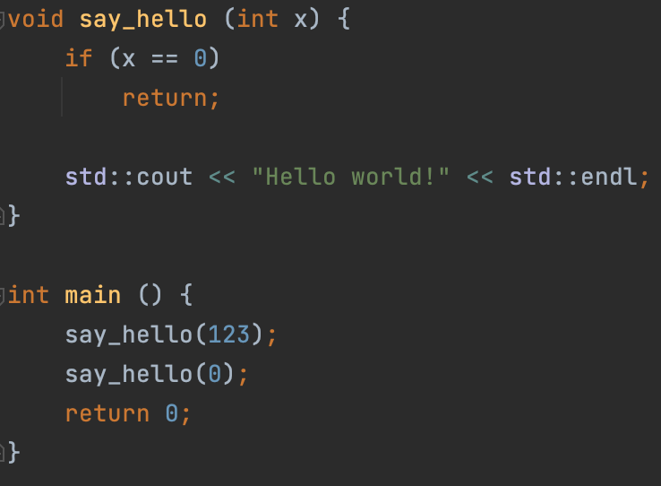
Void
If you want to create a function, which will not return anything, you can use void as a return type:
But still, you can return return keyword:

Slide 21
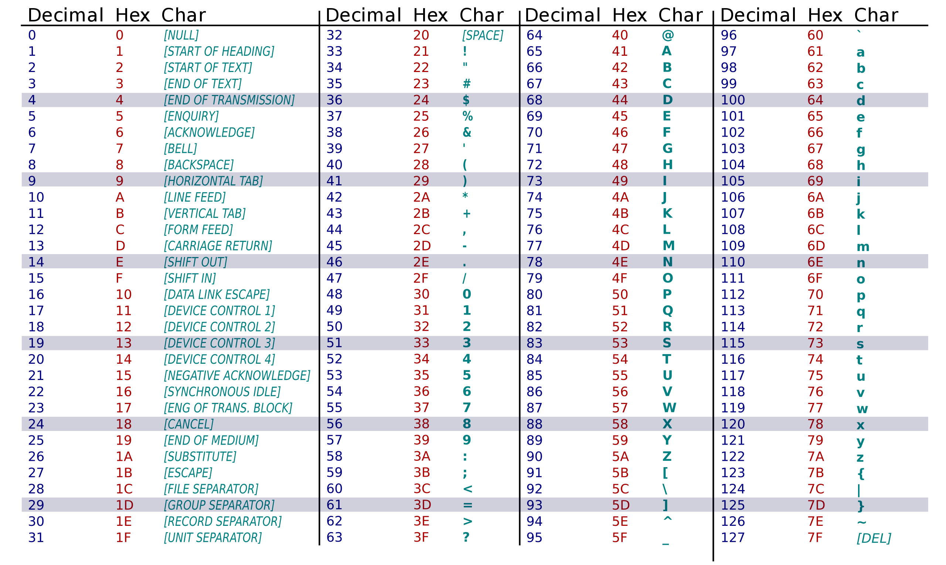
ASCII table

Slide 22
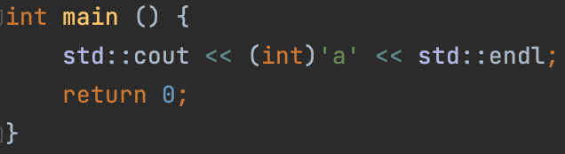
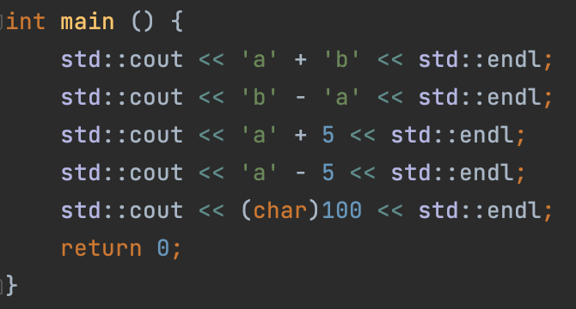

ASCII table
Prints 97:
Arithmetics:

Slide 23
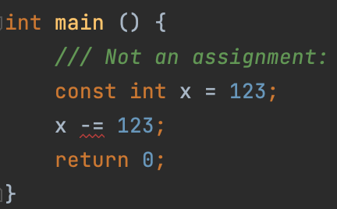
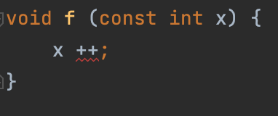
Qualifiers
const qualifier:
Variables declared with const-qualified types are not modifiable. In particular, they are not assignable:
RULE
If you are not going to change the value of a variable, add const-qualifier to it. This will help you to avoid mistakes, because if you try to change the value, the code will not compile.

Slide 24
Types of errors in C++
Compilation error is a situation in which the compiler cannot convert your code to executable.
Lexical error - the written code cannot be recognized by the compiler
Syntax error. Natural language example: a sentence written from random words.
Semantic error: The written text is correct, but it makes no sense. example from natural language: "Eat, please, that table." You cannot make sense and cannot complete the task given to you with the given objects.
Runtime errors can't be predicted at compile time:
Access to unallocated memory.
Stack overflow. stack memory overflow (will discuss later, but a simple example is infinite recursion)
Undefined behaviour (UB):
This is when we write something that the C ++ language standard does not say anything about.

Slide 25
Practice
Problem 1:
Input a number and output it’s bits in a sequence.
Problem 2:
Let’s consider sets of:
Digits
Latin letters (both capital and lowercase ones)
+
-
Implement the next functions:
Input the set
Output set
Unite two sets
Intersect two sets
Invert set
Calculate symmetric difference between two sets
Calculate difference between two sets

Slide 26
Lecture 2
Introduction to C++
Konstantin Leladze
C++ Basics
DIHT MIPT 2021

